Slide 1
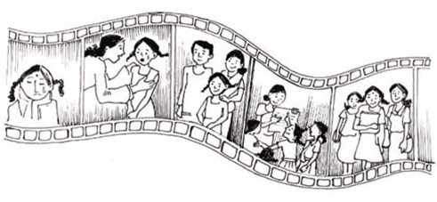
COMMUNITY CONSULTATIONS USING RECIPROCAL RESEARCH: Session 6:
Storyboards
Notes:
Notes to Facilitators - Summary
The story board technique involves asking participants to prepare six pictures, using drawing, or collages of pictures.
The issues to be covered in the story boards can come from storytelling, or from human rights training, or from any other source that is meaningful for the participants.
Participants are asked to draw 6 pictures which become a process of analysis.
The six stages MUST take participants through from describing a problem or issue to be worked on, to a solution and an outcome.

Slide 2
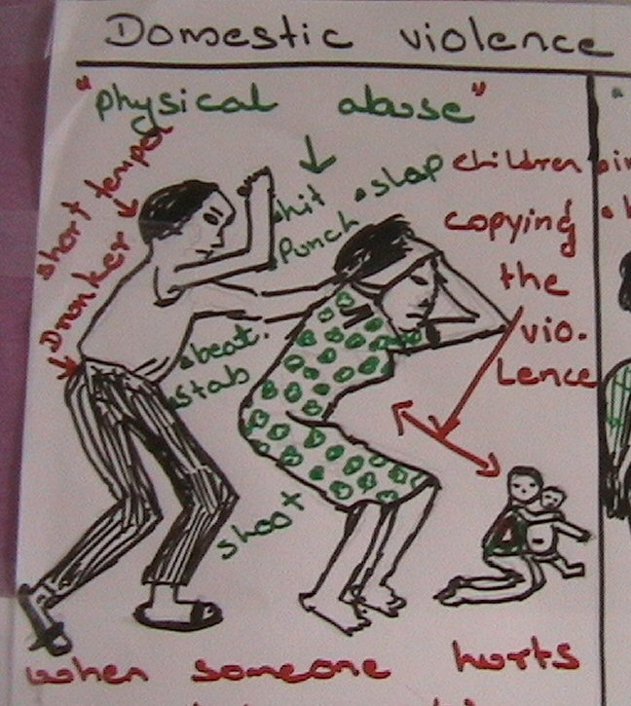
Storyboarding
Storyboarding moves from problem identification to problem solving. It is an excellent way to engage members of refugee communities in identifying appropriate local solutions.
Notes:
This technique has been used with people who are preliterate, women and men, people with tertiary education and a huge diversity of backgrounds.
If people are reluctant because they think it is childish, remind them that there is a saying in English, ‘A picture tells a thousand words”.
Once they start doing it people quickly see the value of the exercise.

Slide 3
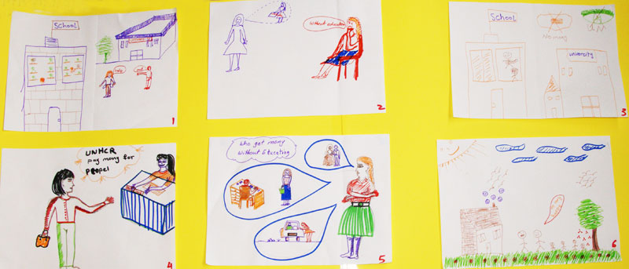
Participants use storyboards to identify problems and suggest solutions
What is a story board?
How story boards can be used to solve problems with refugee communities
Preparing story boards
Notes:
Note to Facilitators
Story Boards analyse problems and suggest solutions
They help people move from story telling to problem solving and goal-setting
They will provide the basis to the response to problems articulated in the story circles
When the participants present their Story boards they will be expected to fully discuss what is happening in each picture and the discussion they had about the issue in their groups. Explain that the facilitators will be asking questions at the end of each presentation to get as much information from the women as possible
The storyboards will be used in reports and advocacy work with service providers
Materials Needed
Each Group will need several large sheets of coloured cardboard, and flip chart paper, coloured paper, big coloured marker pens (thin pens do not make good presentations), scissors, glue, sticky tape – anything you can make for making good poster presentations, and plain A4 paper for each stage of the storyboard.

Slide 4
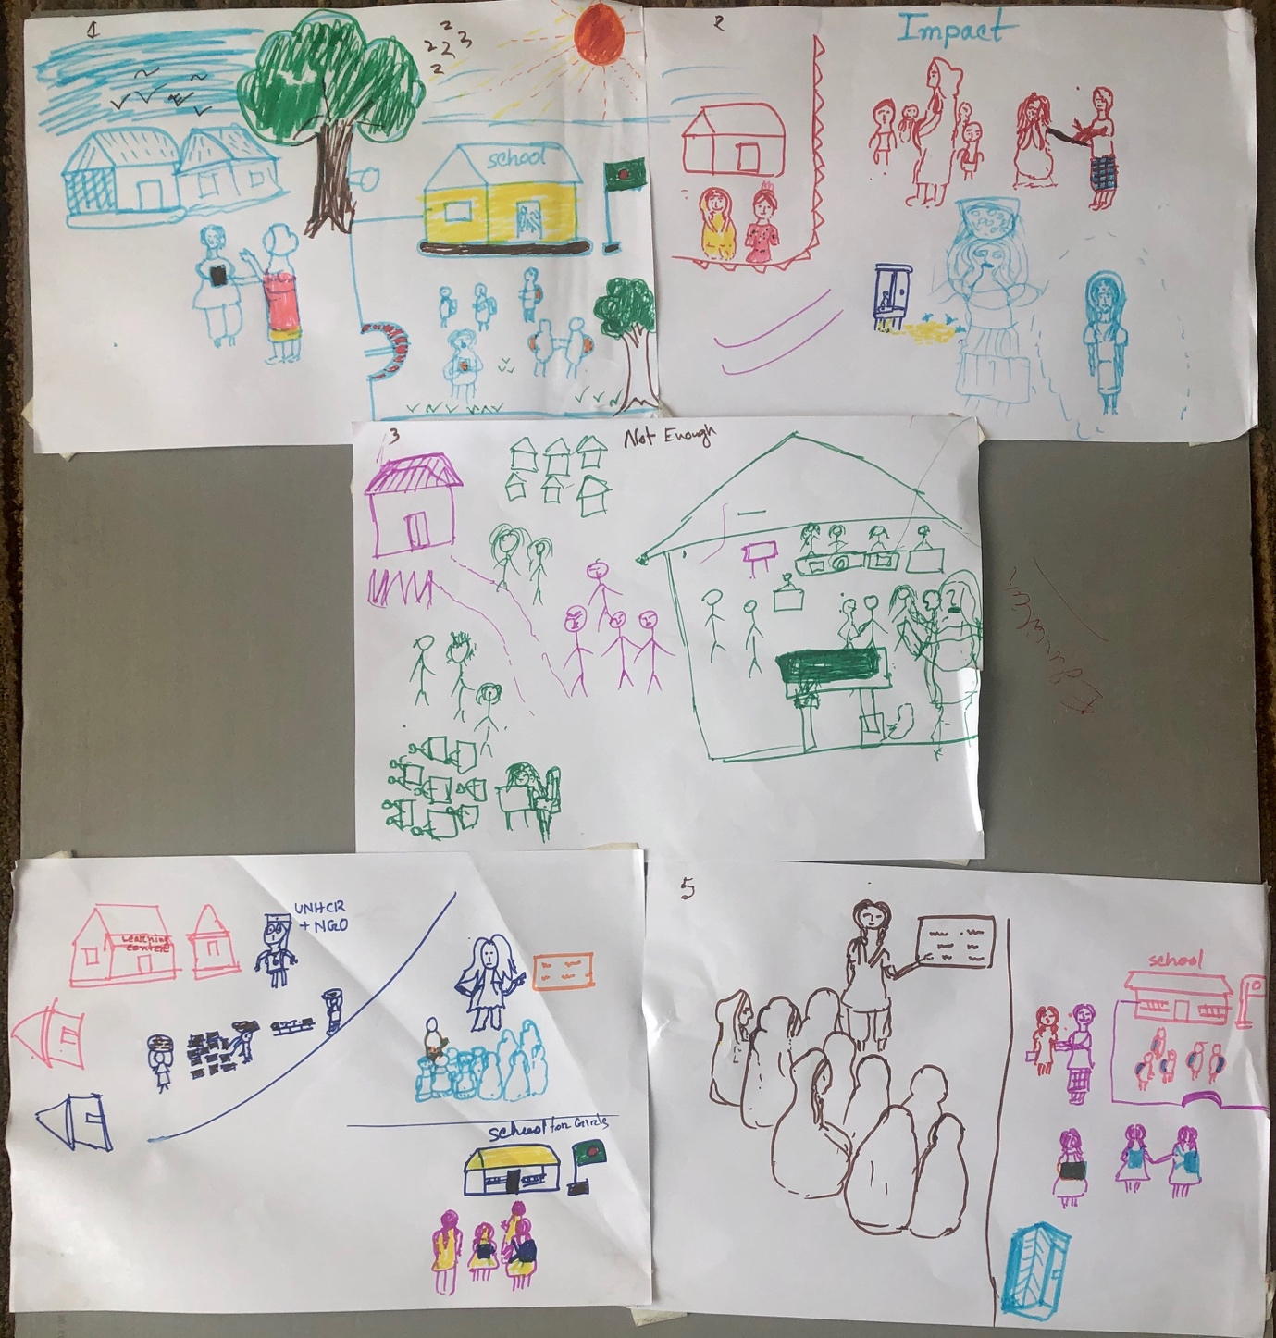
How does it work?
Notes:
In small groups, participants are asked to draw a series of six pictures, answering 6 questions, which start with a depiction of a problem, then the impacts of the problem on individuals, families and communities. Next they are asked to show what assistance is currently available for the problem, then the ‘magic’ question They are asked to draw how they would address the problem, if they were in charge of services. Next comes who they think could help them achieve this, and what support they would need to do it, and lastly, what would be the results of their ideas being implemented.
It is important to decide before the exercise begins what the questions are. This can be done either by the facilitator or with the participants.
It is suggested that the facilitator sets the task and asks the groups to work out what they want to depict and how they will do this before the drawing materials are distributed. This avoids one person taking the materials and drawing before group discussion about the messages they want to give.

Slide 5
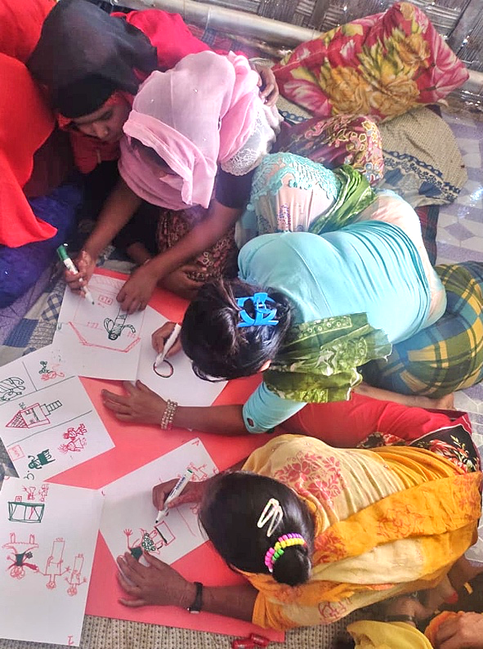
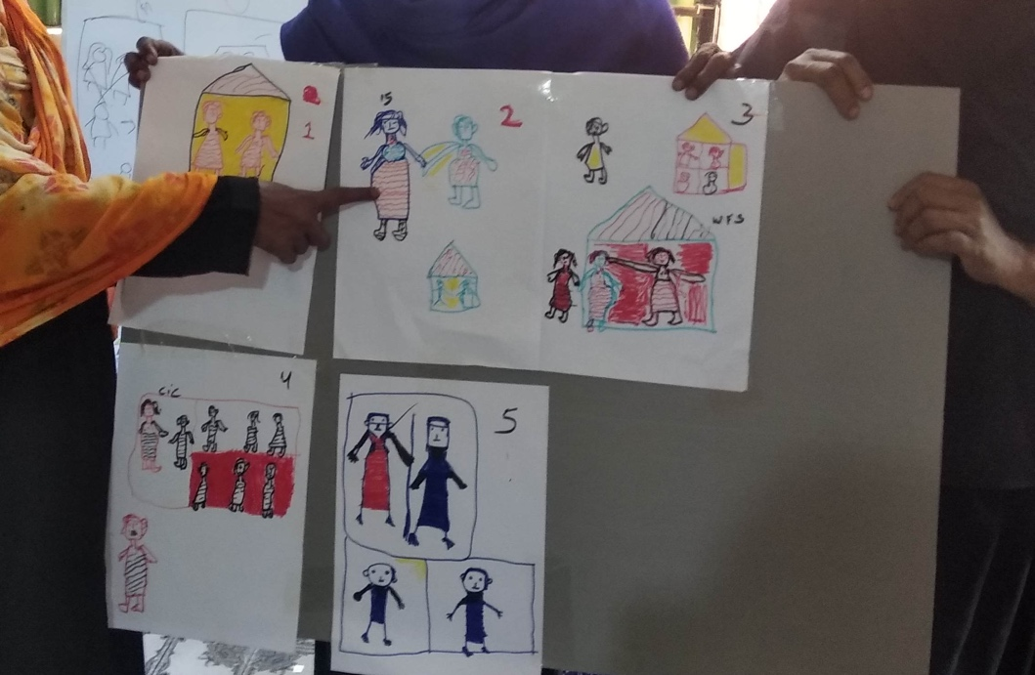
From Problem Identification to Solutions.
The Storyboard Tool
Participants draw and present their responses to questions about a problem facing their community, what is available to respond to this problem, their ideas for other solutions, and what role the community, NGOs or other groups could take in these solutions.
The verbal presentations are documented and form core research data.
Notes:
It can take 15 -20minutes to discuss a story board properly, so keep this in mind when deciding on the number of small groups can be used in the time available.

Slide 6
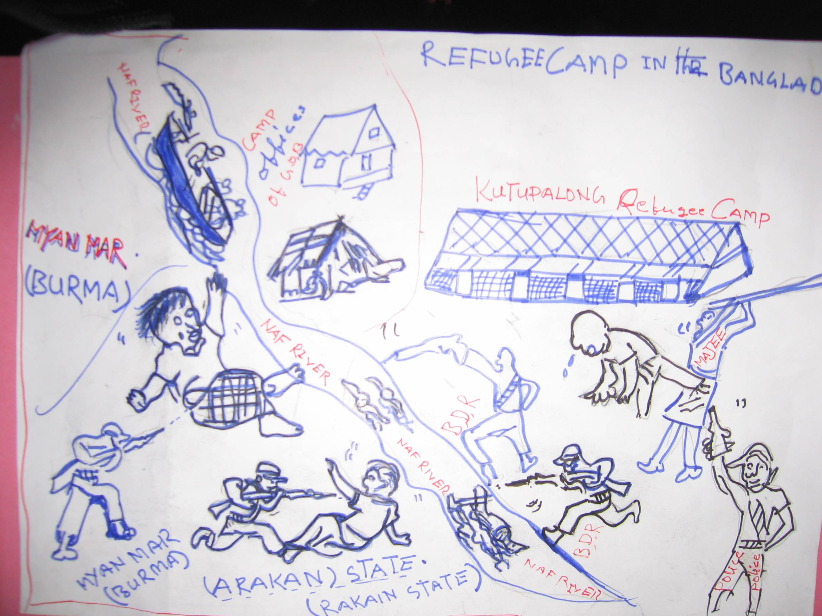
Storyboarding questions could cover:
Depict a problem of concern experienced by people in your community. (An example might be the lack of education for women and girls)
How does it affect the people concerned, what happens to them, how does this affect their families, their communities?
What happens to these women and girls now? (What help is available to them and is it effective?)
Notes:
Depending on the topic, and aims of the session, these can either be set by the facilitator or developed with the group.

Slide 7
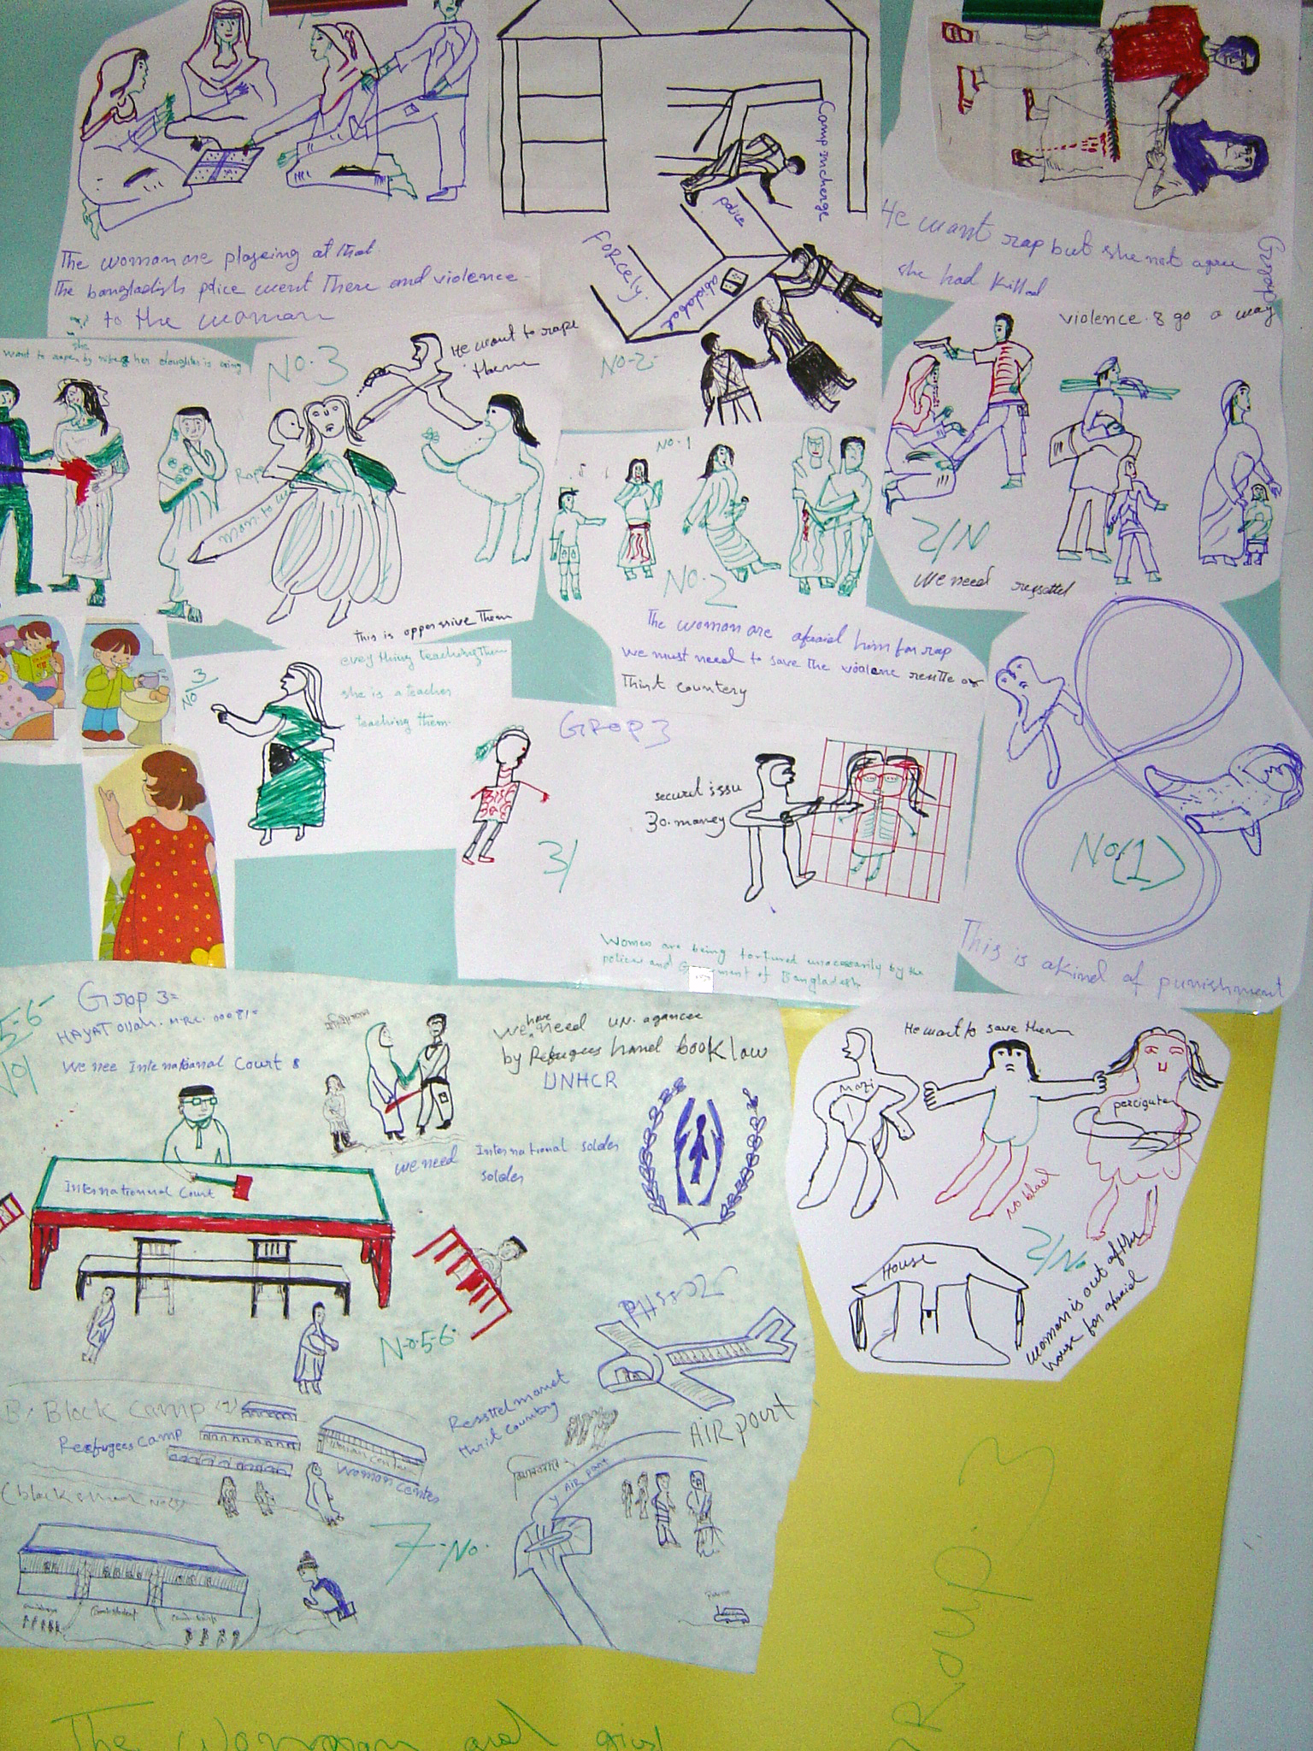
Storyboarding questions continued:
4. If you were in charge of services for this group of people, what would you provide for them, their families and the community, to address this issue?
5. Who else do you think could provide these services, Who would you want to do this, What help would RLWO’s need to address it?
6. If all these services were available what would be the best outcome for these participants?
Notes:
As above.

Slide 8
Documenting the discussion of the drawings
Participants need to be given enough time to fully explain and discuss what they have drawn.
With the permission of participants, this must all be carefully documented and becomes evidence for future actions.
Notes:
A good facilitator will ask questions about the drawings, and what they are saying to draw out details.

Slide 9
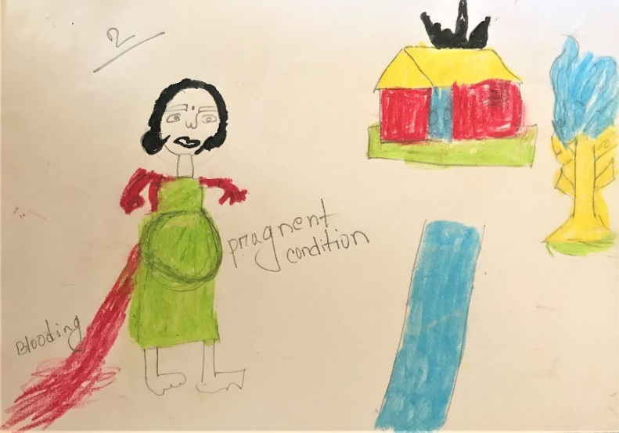
Some examples
A 12 years – old girl is married to a 40 years-old man…. She got pregnant shortly after the wedding. Being pregnant is not good for her health. This time her physical condition is not well. A lot of bleeding from her body. The women facing some problem such as [early pregnancy], they will be physically un-well, they will die, baby will be die when delivery time. (Refugee women Camp 18)
Notes:
The facilitator could explore why the girl was married early, how often this happens in the place where they are, how the women feel when this happens, and how the young girls respond to being forced into early marriage? If they survive, how does the girl cope with being a child mother?

Slide 10
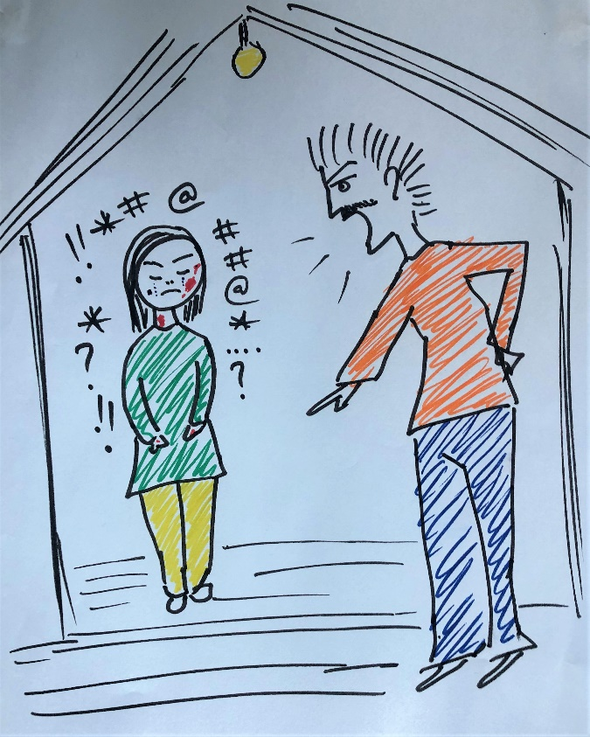
You don’t even need the dialogue!
The topic was abuse including rape by an employer
Refugee Group, Kuala Lumpur 2018
Notes:
Many of the drawings are very explicit. You could ask what the employer is threatening her with, and why it is important she keeps the job.

Slide 11
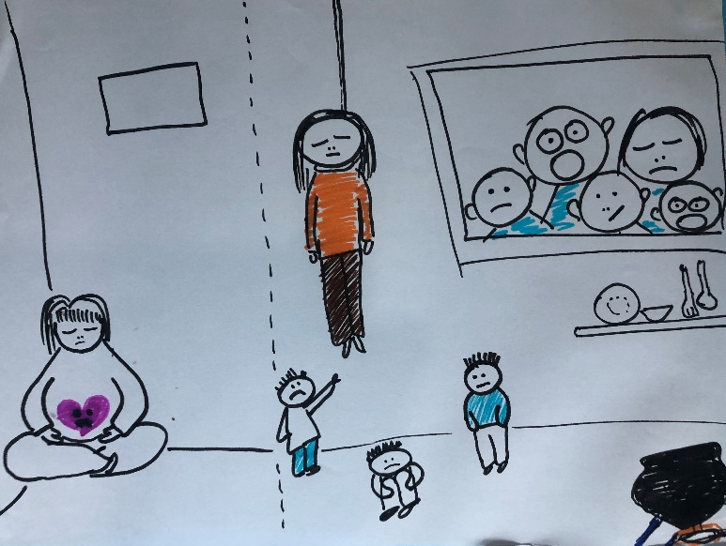
Her response when she finds herself pregnant and the impact on her family
Notes:
Suicide is often reported by women’s groups in situations such as this. Ask how this affects the various members of the family, women leaders and community members.

Slide 12
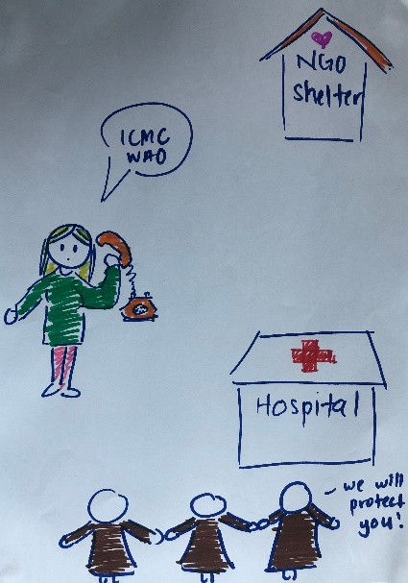
The help the women wanted, but could not always access.
Notes:
How do the women feel when they cannot get help for women in cases like this? Be prepared to hear some angry or ‘defeated’ responses and acknowledge that it is not their fault.

Slide 13
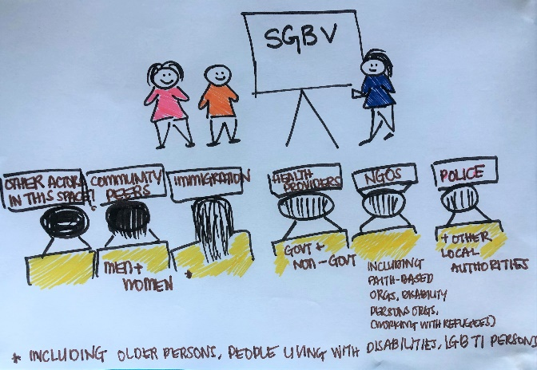
How to achieve change
Notes:
What are their suggests for improved responses and service provision? Help them unpack exactly what it is they want, and what is realistic where they are living.

Slide 14
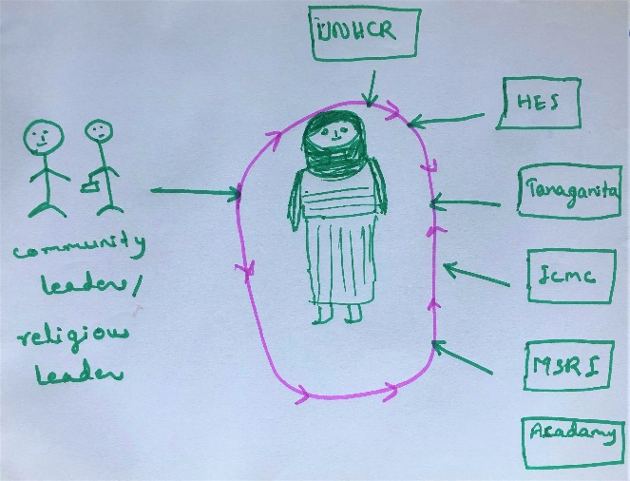
Comprehensive Protection and Care
Notes:
Ask what each of the organisations mentioned could do to provide this circle of protection for the woman.

Slide 15
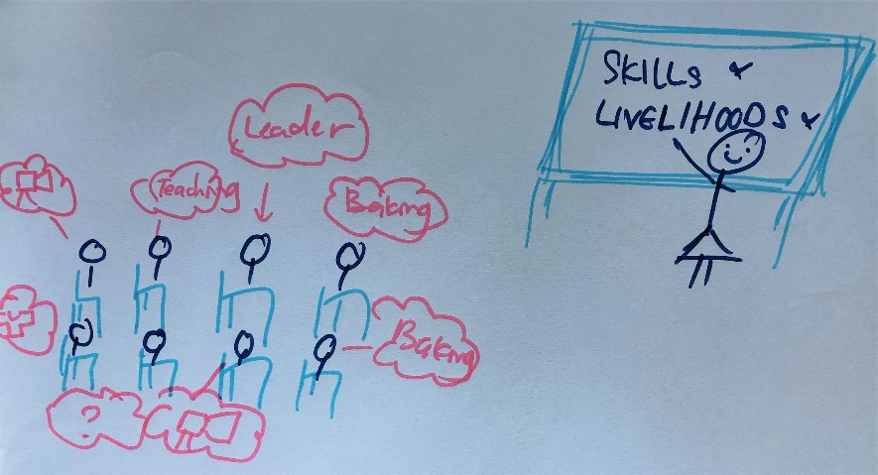
Moving forward – addressing the links between Livelihoods and addressing SGBV
Notes:
The last drawing is not just a ‘happy ending’ Ask the women to make clear links between what they suggest and the root of the problem, for example a lack of safe livelihoods and rape by employers. How will their solutions address this?

Slide 16
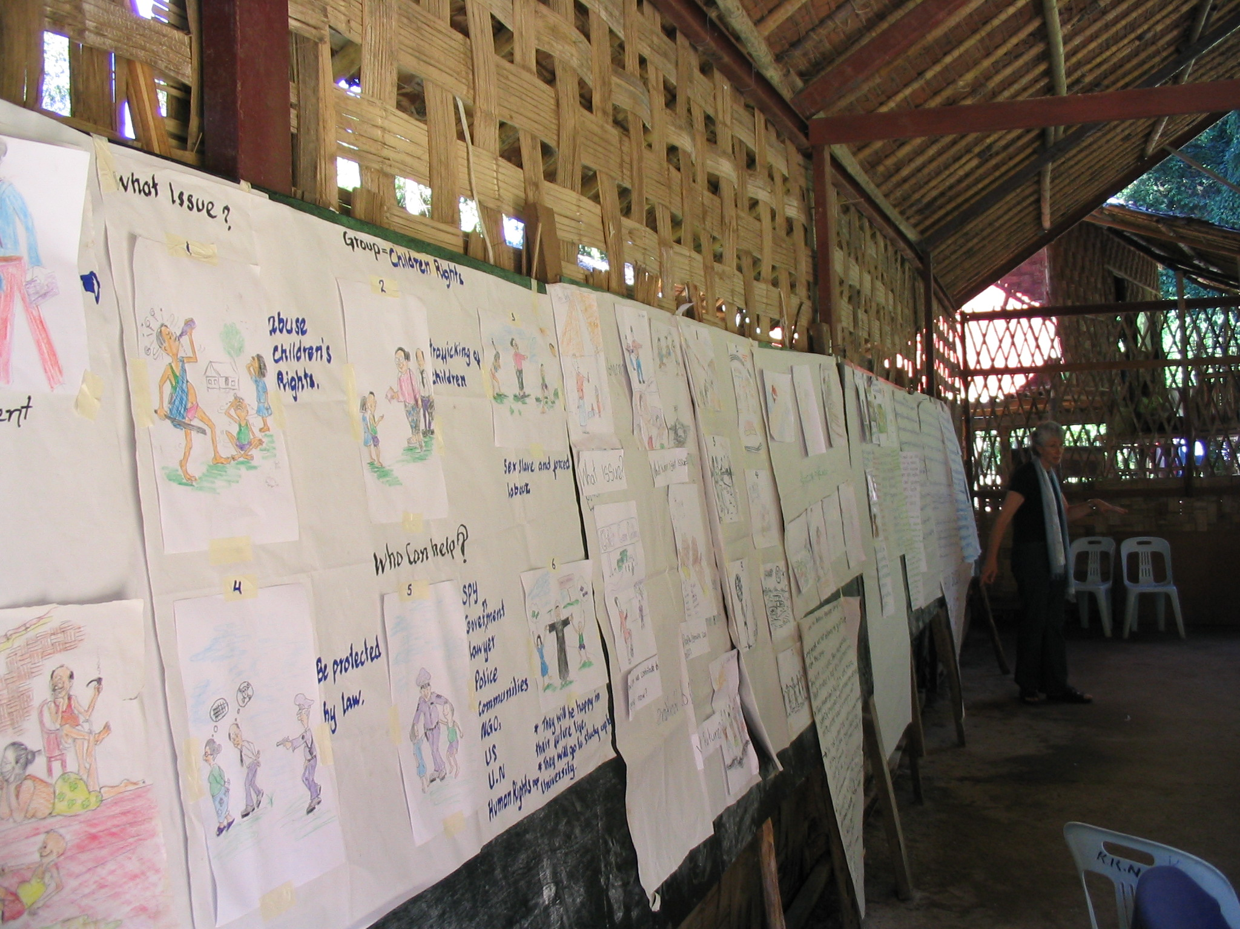
Using the data collected
The outcomes of the story boards will form the basis of the next stage of the risk analysis and response.
Notes:
It is essential that the discussion about the story boards is recorded verbatim by the facilitators.
Take photographs of the story boards, and each of the six drawings to match with the narrative documented for the final report.
Make sure participants approve the reports before they are used for advocacy. This can be set up at the time of the consultations, and spokes- persons appointed who will receive the reports and ensure the women approve what you have included, and any photos you may be using.

