Slide 1
Session 12:
Strategies for the future
Refugee women in leadership:
Power through participation

Slide 2
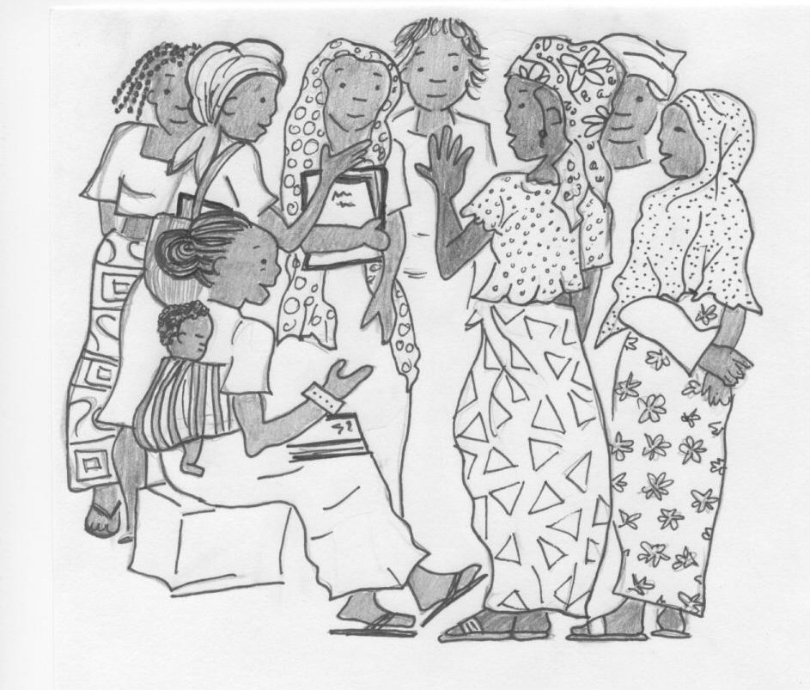
Planning for the future
What to do next?

Slide 3
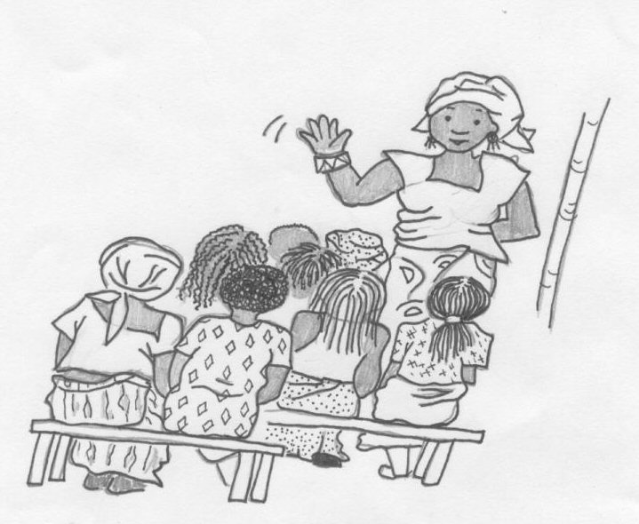
Leaders must be active.
It takes hard work to bring about change.
What can you do now to use your leadership skills to improve life for women and girls in your community?

